Slide 1
designing for the Industrial
Controls market
CONFIDENTIAL: All contents copyright of Illinois Tool Works, Inc. (ITW).
The ITW Photonics Group, Cal Sensors, ITW Linx, Lumex and Opto Diode logos are registered trademarks of ITW, Inc. Copyright © 2013 all rights reserved.

Slide 2

Supporting Industrial Control Companies for Over 30 Years
Industrial Equipment manufacturers make some of the most complex products in the world under highly competitive market conditions. Industrial equipment OEMs are looking for rugged, smarter, faster and higher value solutions. Lumex is a leader in helping to meet the challenges providing new optoelectronic and display technology
specifically designed for performance and endurance, to create feature-rich, high value solutions within focus niches such as:
Automation Controls
Mass Flow Controls
Industrial Power Systems
Alternative Energy Systems
Industrial Equipment
AMR Metering
Our broad product portfolio assists industrial equipment manufacturers meet the various demands of designing for increased product complexity, while maintaining quality performance and safety requirements.
• -40˚C to +85˚C extreme temperature technologies
• LED backlights, able to withstand temperatures up to 100˚C
• High intensity LED displays, able to withstand temperatures up to 105˚C
Lumex Product Families
High Power LEDs
Extreme Temperature LEDs
Thru-Hole & SMD LEDs
Panel & PCB Indicators
LED Displays
LED Arrays
Light Pipes
Infrared Devices
Monochromatic & Color LCDs
EXTREME
TEMPERATURES
DAYLIGHT VISIBILITY
Design Factors for Industrial Control Applications
SHOCK RESISTANCE
RESPONSE
TIME
CONFIDENTIAL: All contents copyright of Illinois Tool Works, Inc. (ITW).
The ITW Photonics Group, Cal Sensors, ITW Linx, Lumex and Opto Diode logos are registered trademarks of ITW, Inc. Copyright © 2013, all rights reserved.

Slide 3
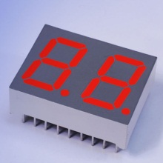
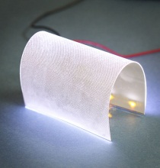
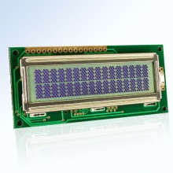
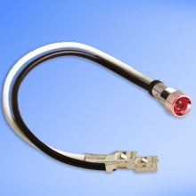
Product Components Ideal for Rugged Environments
SMD & Thru-Hole High Temp LED Displays
Market-leading, operating temperatures up to 105˚C
Single & dual digit layouts available in standard stock
Triple or quad digit layouts available with no additional tooling
Industry 1st, Shapeable, Flexible LED Backlight!
Unique backlight can be shaped (i.e., to allow space for a switch or other component on the circuit board) without causing shadowing or a compromising light performance
Profile height of just 0.125mm (97% thinner than traditional backlights)
Specially designed ultra-thin surface, specifically designed for enhanced light distribution
Extreme Temp Character & Graphic LCD Modules
Offering temperature ranges from -40˚C to +85˚C with consistent hot and cold start LCD performance
Provides high-resolution, high-duty daylight visibility
Available in either positive or negative image display
120 Volt AC LED Panel Indicators
Eliminates the need for AC to DC power conversion
Wire lengths range from 6” to 6’ with a variety of connector options
Additional voltage indicators available from 2V-DC thru 120V-AC
CONFIDENTIAL: All contents copyright of Illinois Tool Works, Inc. (ITW).
The ITW Photonics Group, Cal Sensors, ITW Linx, Lumex and Opto Diode logos are registered trademarks of ITW, Inc. Copyright © 2013, all rights reserved.

Slide 4
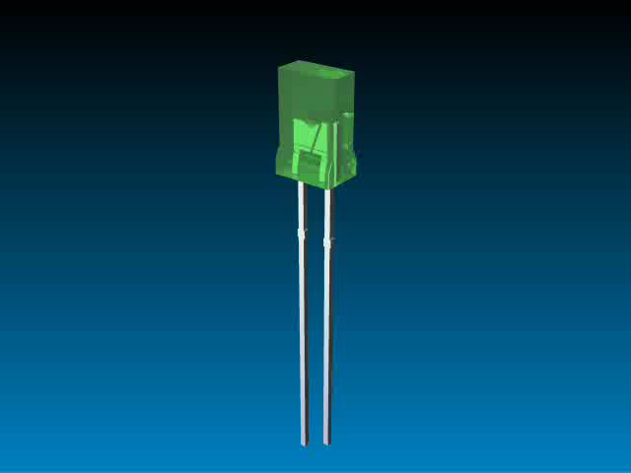
Multiple Technologies…
One Product Solution
In today’s competitive marketplace, many engineers are finding that many standard technologies do not meet all of their needs.
More and more, design engineers are recognizing that an application-specific solution will offer the best result for more complex design needs.
Lumex has proven success at translating initial design concepts and turning them into reality.
Whether addressing a current
design challenge or integrating
multiple components into one
sub-assembly, Lumex will work
with you from initial prototype
through final production.
Lumex offer experience,
quality and innovative originality
to help bring products to market
faster and help provide that
competitive edge.
Benefits of
Value Add Solutions
Focus on application needs
Stand out from competition
Enhanced reliability
Speed time to market
Reduced labor costs
Faster ROI
Full plug ‘n play solution
Engineering know-how that acts as an extension of your own team
CONFIDENTIAL: All contents copyright of Illinois Tool Works, Inc. (ITW).
The ITW Photonics Group, Cal Sensors, ITW Linx, Lumex and Opto Diode logos are registered trademarks of ITW, Inc. Copyright © 2013, all rights reserved.

